Slide 1

FactoryGirl
Improving testing with factorygirl

Slide 2
GETTING STARTED
Add “Gem install ‘factory_girl’” to Gemfile and run bundle install
Or simply run `gem install factory_girl` from the shell

Slide 3
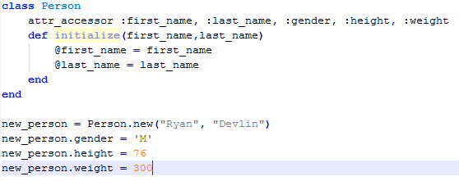

Slide 4
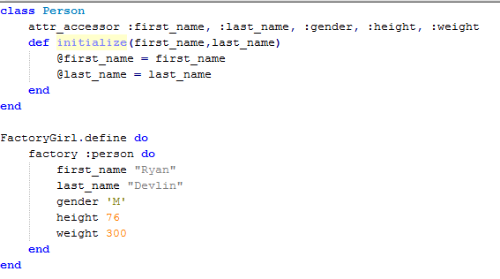

Slide 5


Slide 6


Slide 7
THANKS

